Slide 1

Consumer Goods Ad hoc Insights
Atliq Hardwares
Presented by Akshay Wagh

Slide 2
Introduction
Atliq hardware is a leading computer hardware producer in India, with operations across multiple countries.
The management seeks quick, smart, data-informed decisions to improve business efficiency.
This project aims to deliver business insights using sql queries to solve ad-hoc requests from the management.

Slide 3
Objective
Address all ad-hoc requests.
Uncover hidden insights to meet the business needs.
Provide data-driven insights for the top-level management to make strategic business decisions.
Utilize SQL queries to extract key information from the database.

Slide 4
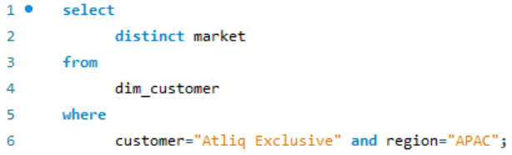
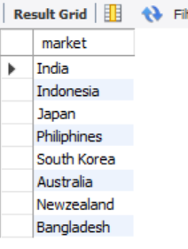
Request – 1 Provide the list of markets in which customer "atliq exclusive" operates its business in the APAC region.
Query
Output

Slide 5
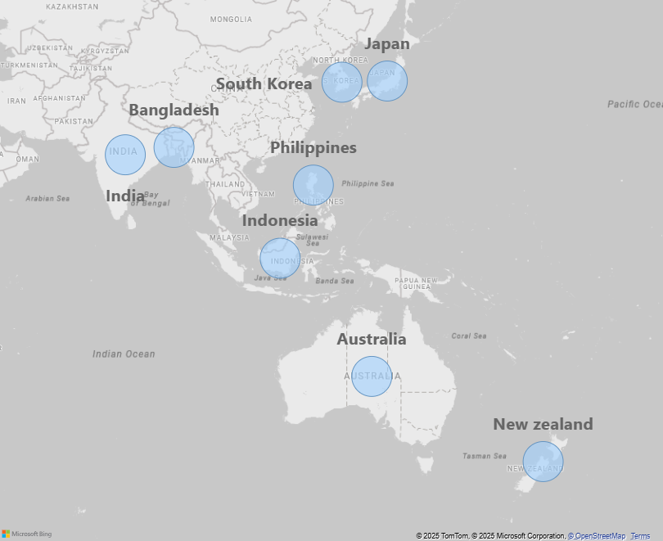
Atliq Exclusive's marketing countries in APAC region
Insights
Atliq Exclusive operates in 8 major markets across the APAC region, showcasing its strong footprint and business expansion in this region.

Slide 6
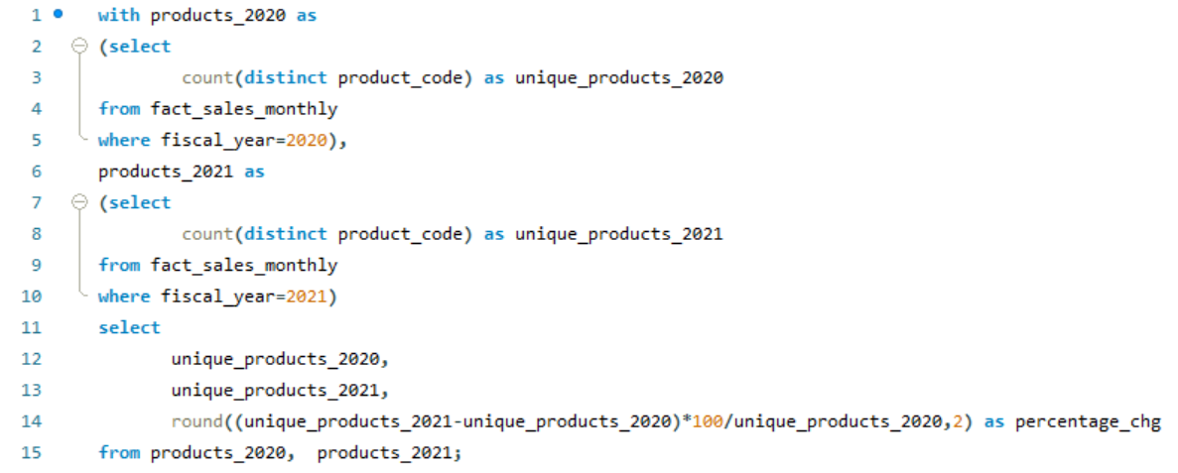
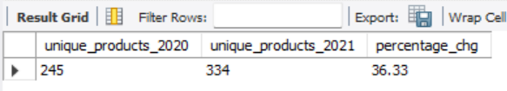
Request – 2 What is the percentage of unique product increase in 2021 vs. 2020? The final output contains these fields, unique_products_2020 unique_products_2021 percentage_chg
Query
Output

Slide 7
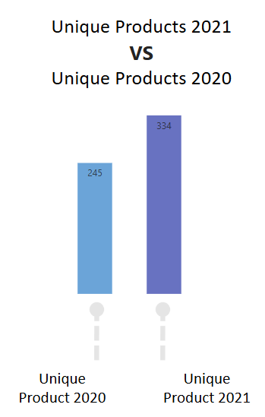
Insights
Atliq Hardware's 36.33% rise in unique products shows its focus on innovation and meeting customer needs.

Slide 8
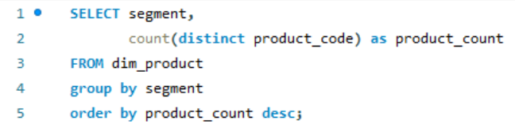
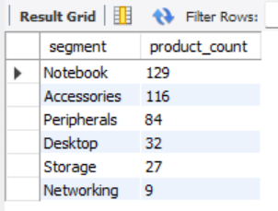
Request – 3 Provide a report with all the unique product counts for each segment and sort them in descending order of product counts. The final output contains 2 fields, segment product_count
Query
Output

Slide 9
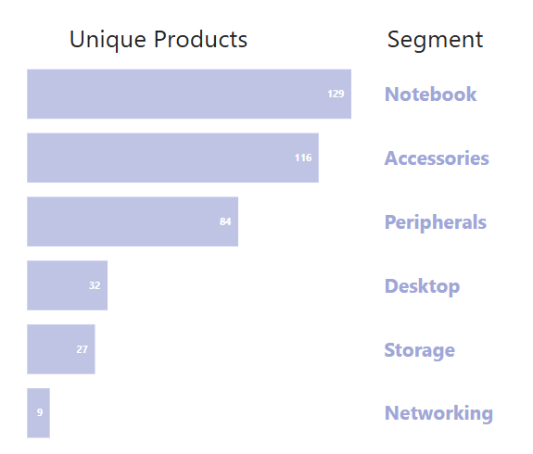
Insights
Strong Segments: Notebooks, Accessories, and Peripherals dominate, averaging 110 products per segment.
Weak Segments: Desktops, Storage, and Networking lag behind, averaging 23 products per segment.
Action Needed: The Product Development team should redesign or improve products in weaker segments.
Growth Focus: Innovation in strong segments will maintain market leadership, while weaker segments need growth strategies.

Slide 10
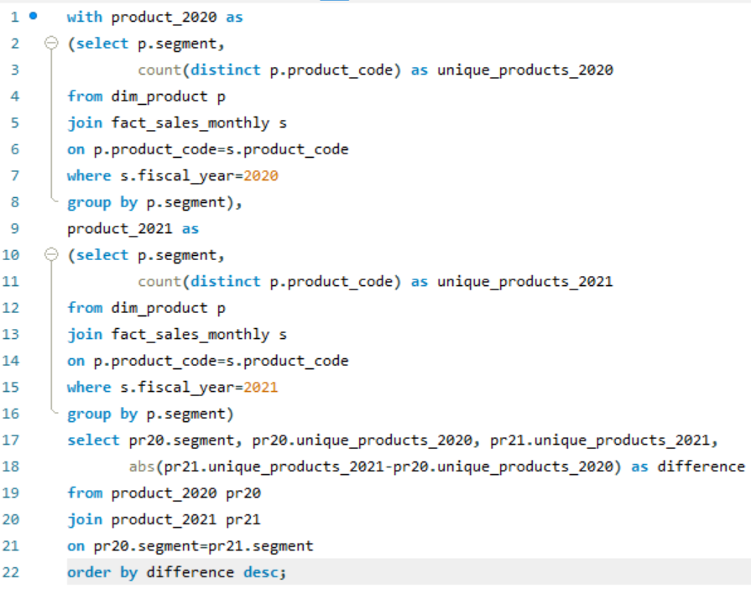
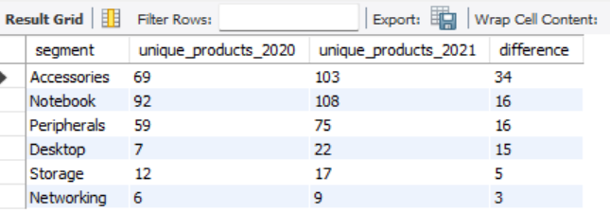
Request – 4 Which segment had the most increase in unique products in 2021 vs 2020? The final output contains these fields, segment | product_count_2020 | product_count_2021 | difference
Query
Output

Slide 11
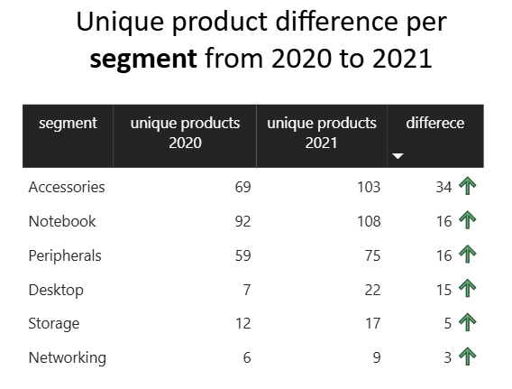
Insights
Top Growth: Accessories had the highest increase, adding 34 unique products from 2020 to 2021. Steady Growth: Notebooks, Peripherals, and Desktops grew by 15–16 unique products. Low Growth Segments: Storage and Networking had small increases, adding 5 and 3 unique products. Action Plan: Focus on Accessories to maintain growth. Identify what drives growth in Notebooks and Peripherals. Find ways to improve product diversity in Storage and Networking.

Slide 12
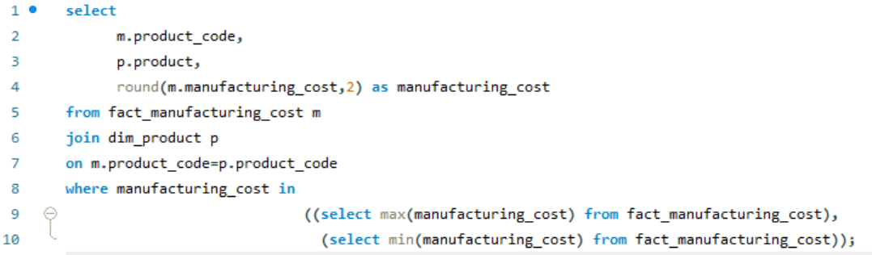
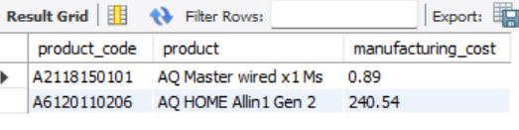
Request – 5 Get the products that have the highest and lowest manufacturing costs. The final output should contain these fields, product_code | product | manufacturing_cost
Query
Output
Insights
The AQ HOME Allin1 Gen 2 has the highest manufacturing cost. The AQ Master wired x1 Ms has the lowest cost. Focus on optimizing pricing for high-cost products and boosting sales for low-cost ones.

Slide 13
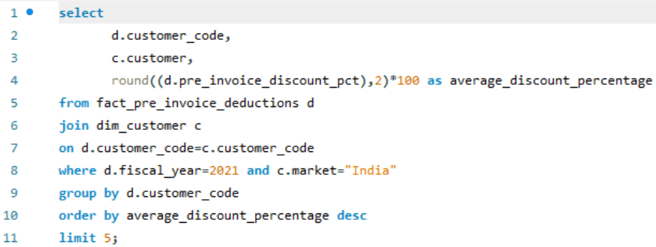
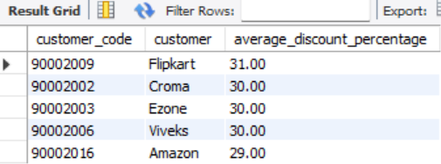
Request – 6 Generate a report which contains the top 5 customers who received an average high pre_invoice_discount_pct for the fiscal year 2021 and in the Indian market. The final output contains these fields, customer_code | customer | average_discount_percentage
Query
Output

Slide 14
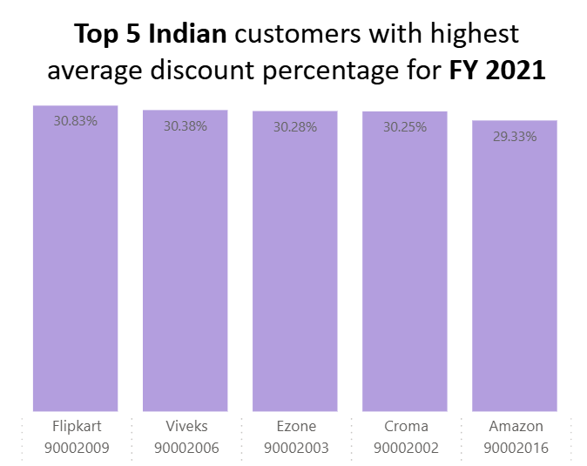
Insights
The largest average pre-invoice discount was given to Flipkart (31%).
The least average pre-invoice discount was given to Amazon (29%).
Most top customers received a 30% discount, showing a similar pricing strategy.
Consider evaluating profitability and negotiation strategies for these key customers.

Slide 15
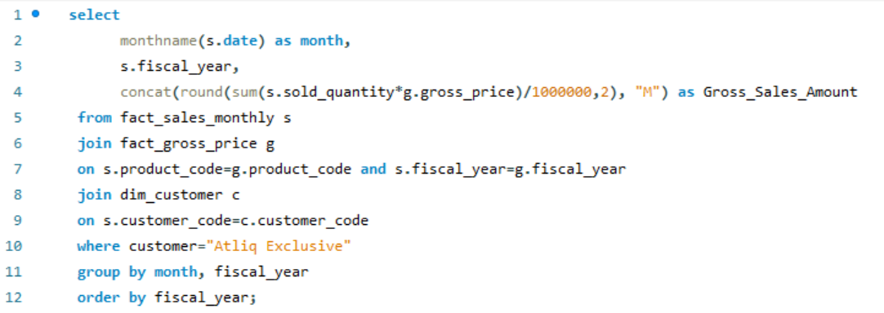
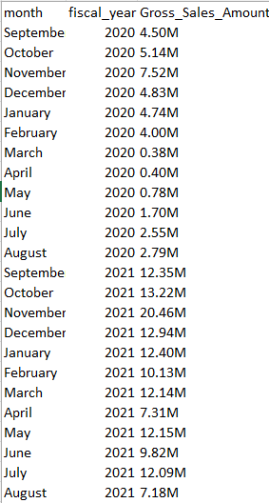
Request – 7 Get the complete report of the Gross sales amount for the customer “Atliq Exclusive” for each month. This analysis helps to get an idea of low and high-performing months and take strategic decisions. The final report contains these columns: Month | Year | Gross sales Amount
Query
Output

Slide 16
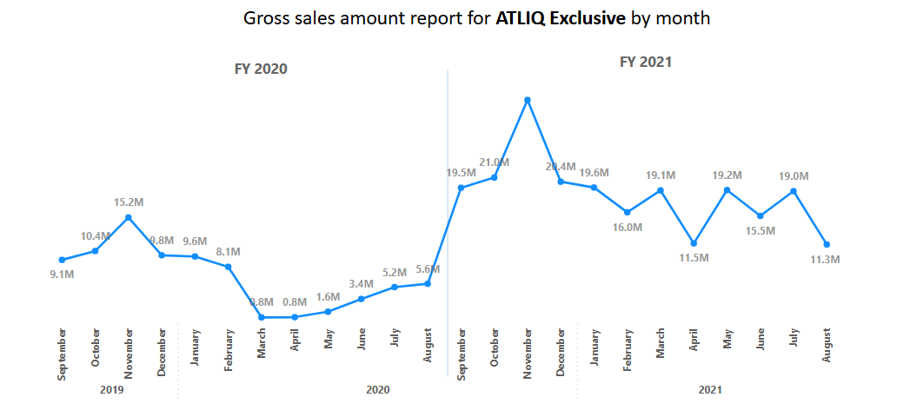
Insights
Atliq Exclusive's highest sales were in November 2020, and the lowest were in March 2020 because of the pandemic. Sales improved from September 2020 as lockdowns eased and festivals began.

Slide 17
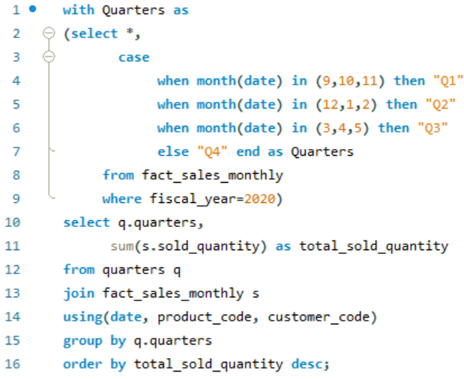
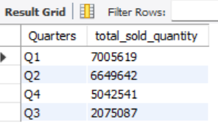
Request – 8 In which quarter of 2020, got the maximum total_sold_quantity? The final output contains these fields sorted by the total_sold_quantity, Quarter | total_sold_quantity
Query
Output

Slide 18
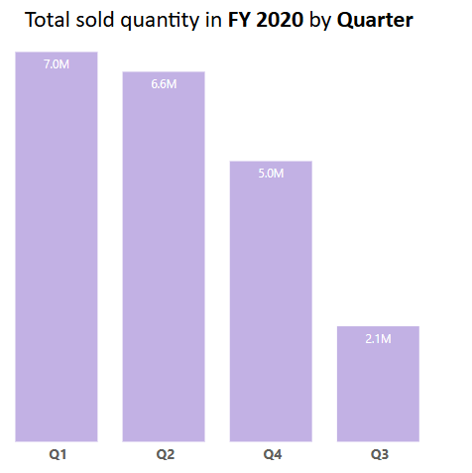
Insights
Q1 of 2020 had the highest total sold quantity, indicating strong demand during this period. Q3 had the lowest sales, suggesting lower seasonal demand or supply constraints. To maximize sales, the company can analyze Q1 trends and apply similar strategies to weaker quarters.

Slide 19
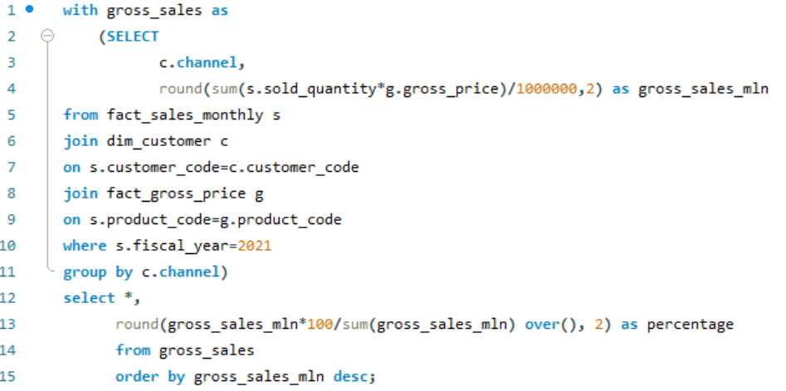
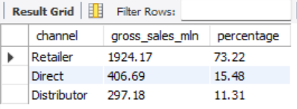
Request – 9 Which channel helped to bring more gross sales in the fiscal year 2021 and the percentage of contribution? The final output contains these fields, channel | gross_sales_mln | percentage
Query
Output

Slide 20
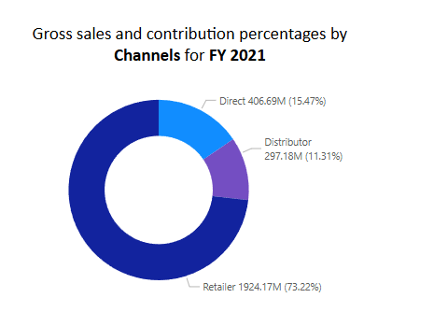
Insights
The Retailer channel was the primary revenue driver, contributing 73.22% of gross sales.
The Distributor channel had the lowest contribution at 11.31%.
Expanding direct sales and improving distributor performance could help diversify revenue sources.

Slide 21
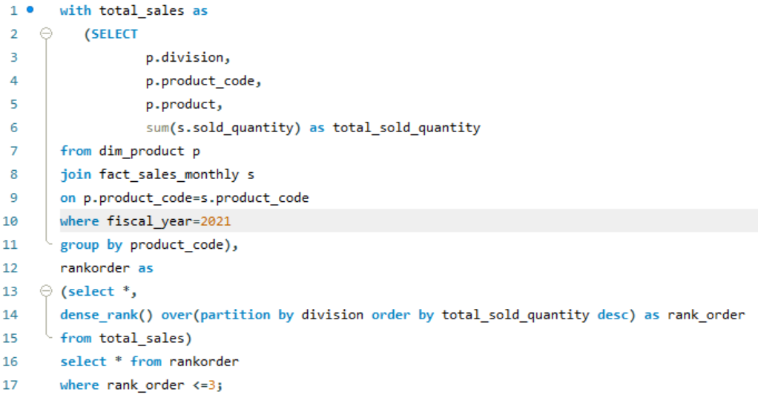
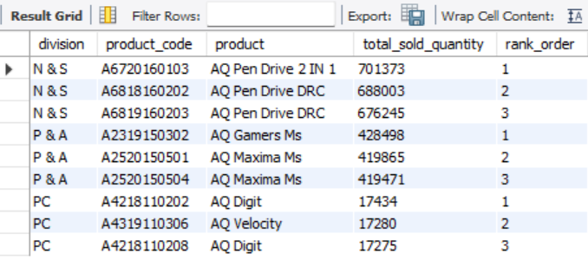
Request – 10 Get the Top 3 products in each division that have a high total_sold_quantity in the fiscal_year 2021? The final output contains these fields, division | product_code | product | total_sold_quantity | rank_order
Query
Output

Slide 22
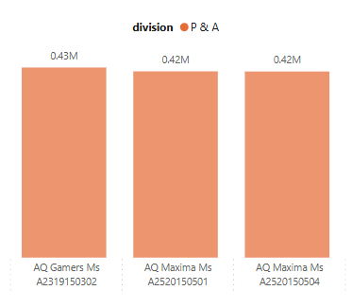
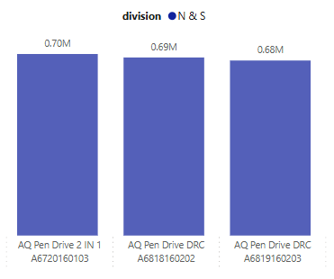
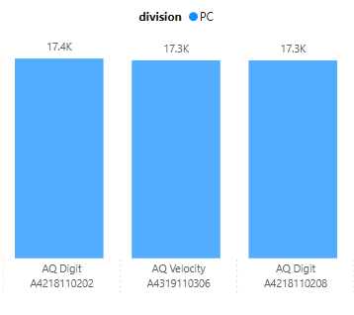
Top 3 highest-selling products by Division for FY 2021
Insights
Each division has a product with different variants appearing twice in the top three. In N&S, AQ Pen Drive DRC has two variants with strong sales. In P&A, AQ Maxima Ms appears twice, showing high demand. In PC, AQ Digit has two versions with close sales figures.

Slide 23
THANK YOU

